Slide 1
MODULE 2: BASELINE ASSESSMENT
Session 4: Livelihood Zoning

Slide 2
Purpose and content of session
To review the key features of a livelihood zone and provide participants with the knowledge and tools for verifying, refining and revising a livelihood zone.

Slide 3
By the end of this session, participants should be able to
• Describe the key factors that determine livelihood zones and how a livelihood zone map differs from other kinds of map such as land use maps, production maps etc.
• Know how to obtain information on livelihood zones from district-level key informant interviews.
• Realise when, in the field, they are in a village in the wrong livelihood zone and know what to do about it

Slide 4
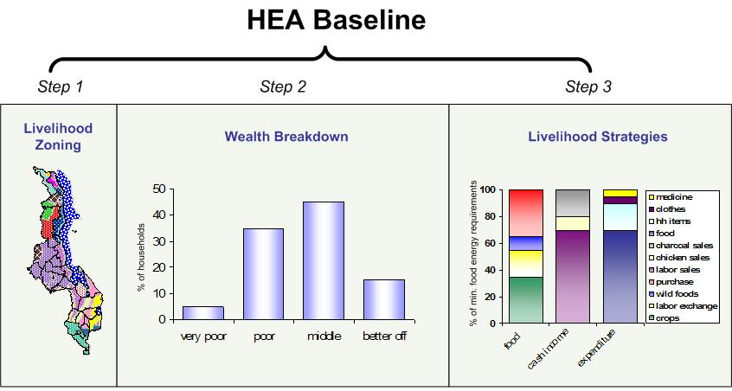
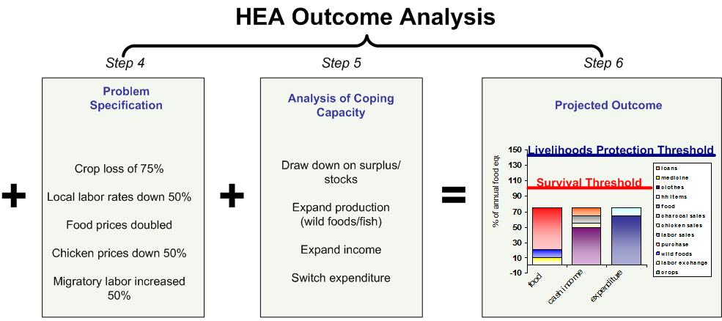
Where Livelihood Zoning Fits
Livelihood Zoning is the first step in an HEA baseline. It establishes the context in which all further work is done.
Session 4: Livelihood Zoning

Slide 5
What is a Livelihood Zone?
A Livelihood Zone is an area within which people share broadly:
the same means of production
the same access to markets
Session 4: Livelihood Zoning

Slide 6
What defines a Livelihood Zone?
Geography: Because this determines what people can grow and where they can trade
Production: What people do grow or raise
Markets: Where people trade their goods (including their labour)
Session 4: Livelihood Zoning

Slide 7
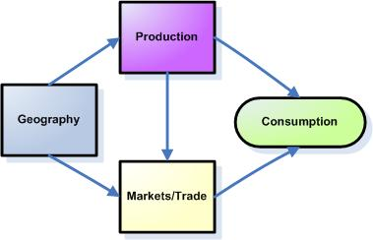
What defines a Livelihood Zone?
Session 4: Livelihood Zoning

Slide 8
What defines a Livelihood Zone?
For example, in this case, production does not warrant a split in zones…..
Upper Limpopo Livelihood Zone
Most consumption is from own maize production in both areas
Lower Limpopo Livelihood Zone
Session 4: Livelihood Zoning
Notes:
In this example, it’s clear that poor households in both of these riverine zones rely heavily on their own maize production to meet annual food needs in a typical year.

Slide 9
What defines a Livelihood Zone?
…but market access does.
Upper Limpopo Livelihood Zone
Food stocks help make up for a maize failure but a deficit remains
Remittance income from South Africa offsets the maize failure in this zone
Lower Limpopo Livelihood Zone
Session 4: Livelihood Zoning
Notes:
But in a bad year they have different options to turn to.

Slide 10
How are Livelihood Zones used in HEA?
In HEA, livelihood zones are used as the sampling frame for baseline assessment and as a component of the reference population group for outcome analysis
Session 4: Livelihood Zoning

Slide 11
Some Tips on Verification
Within a single wealth group you should find the same:
Types of crops being planted
Types of commodities sold
Areas sought out for local and migrant labour
Session 4: Livelihood Zoning

Slide 12
Some Tips on Verification
If you are consistently coming up with significant differences within a wealth group, you may need to consider splitting the zone
Session 4: Livelihood Zoning

Slide 13
Some Tips on Verification
However, the occurrence of a drought in one part of a zone does not warrant dividing it up into two separate livelihood zones
Session 4: Livelihood Zoning

Slide 14
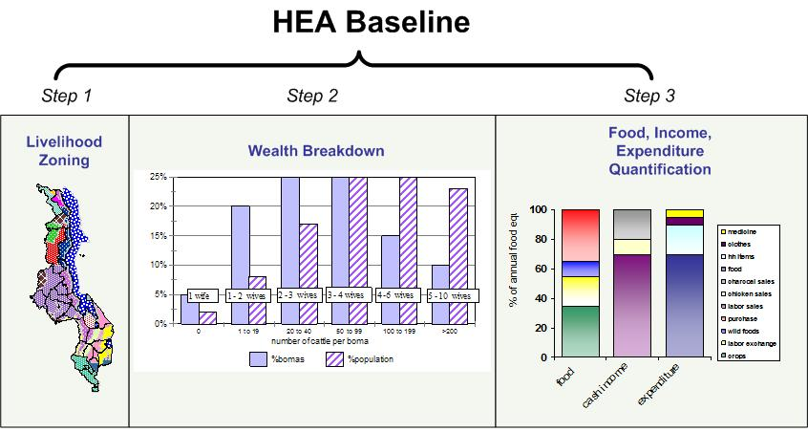
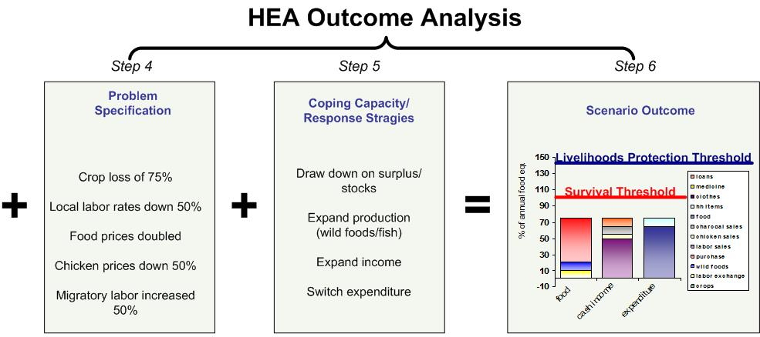
Some Tips on Verification
The drought is a hazard – not part of the baseline, but the outcome analysis
Session 4: Livelihood Zoning

Slide 15
Some Tips on Verification
Similarly, differences in service provision (number of clinics, schools, etc) do not necessarily reflect different livelihood patterns and would not warrant splitting the zone.
Session 4: Livelihood Zoning

Slide 16
Further Reading
Please refer to Chapter 2 in the Practitioners’ Guide for more detailed guidance on how to conduct a livelihood zoning
Session 4: Livelihood Zoning

Slide 17
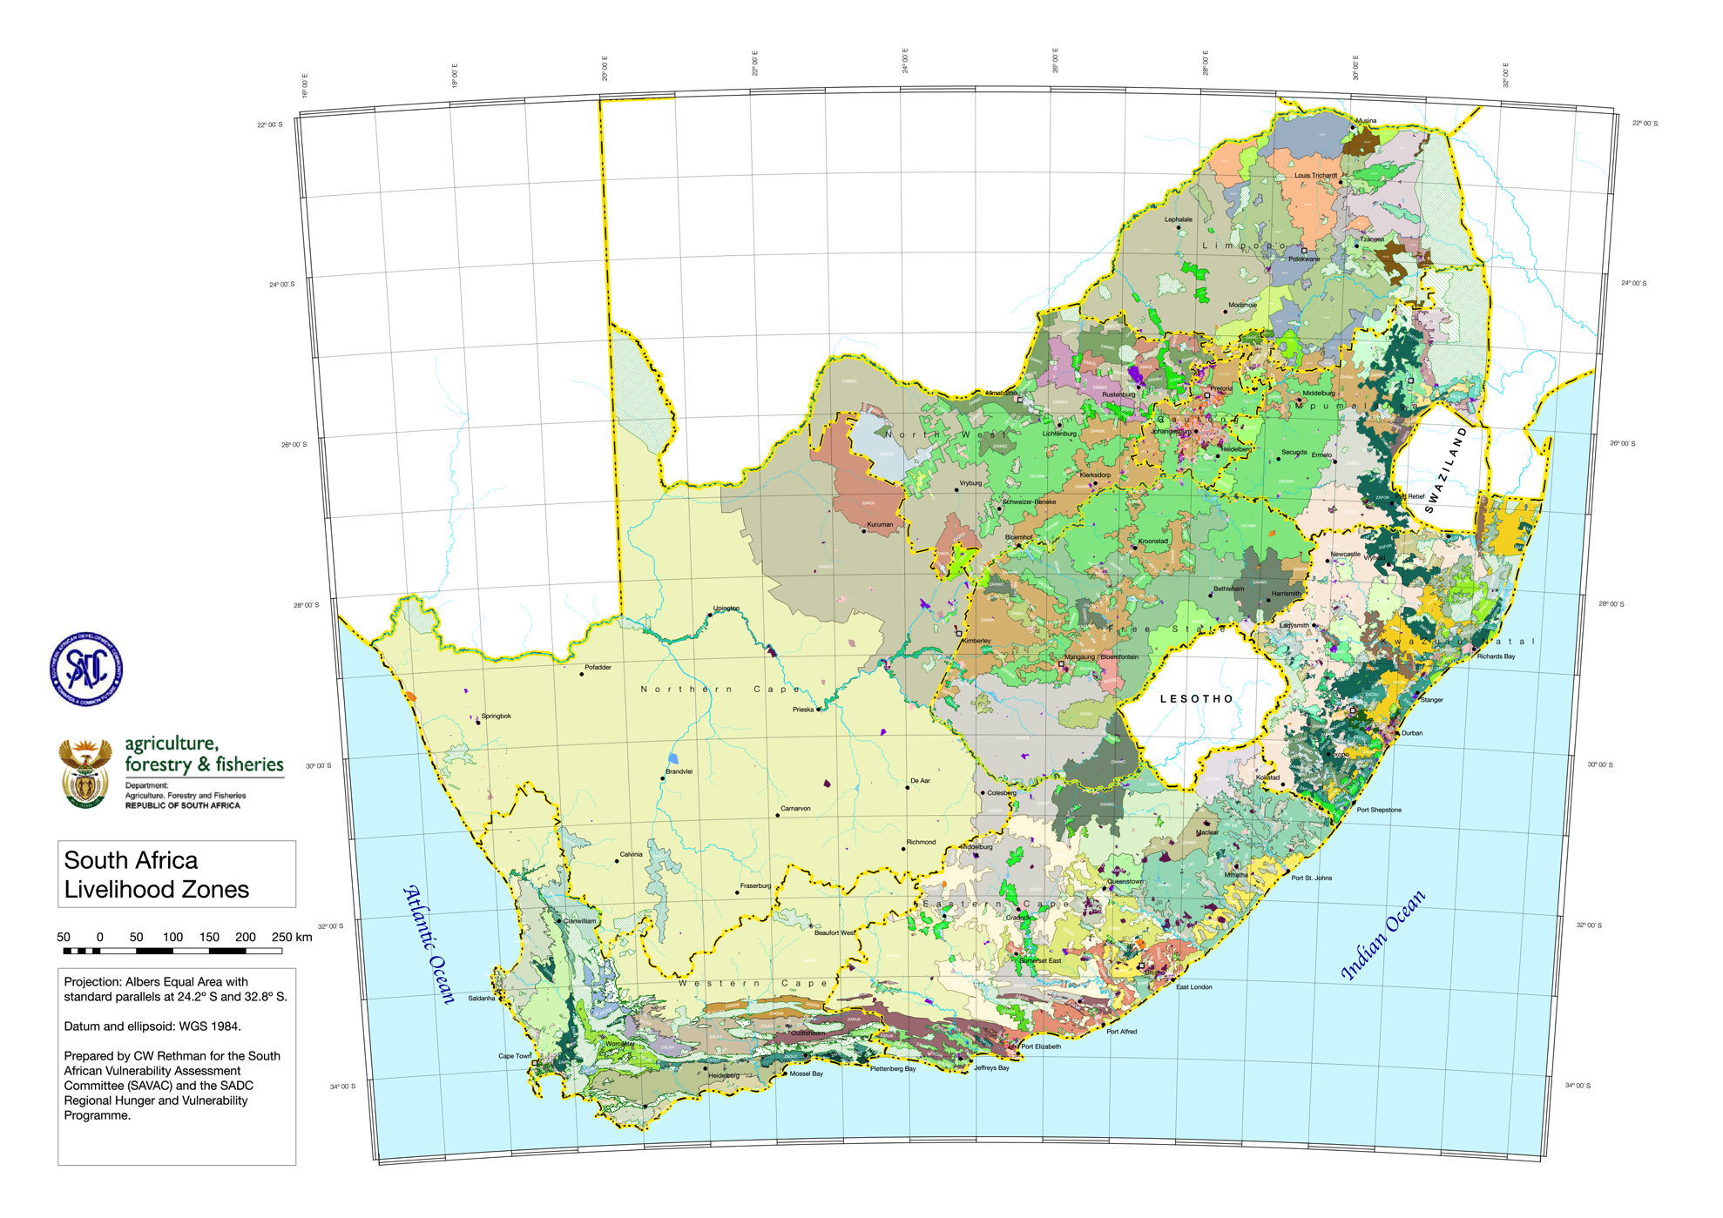
South Africa Livelihood Zones

